Slide 1

Map/Reduce with Linq & F#

Slide 2
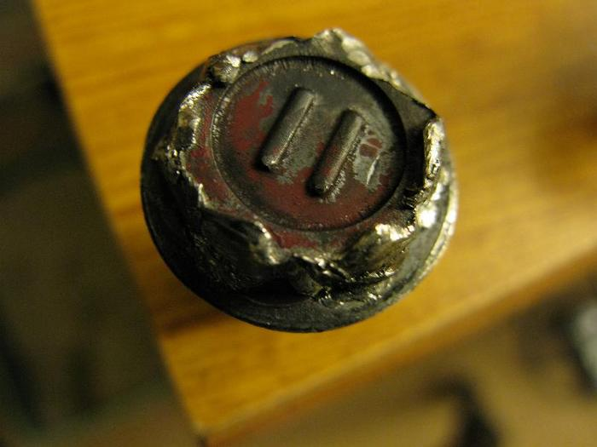
The problem:

Slide 3

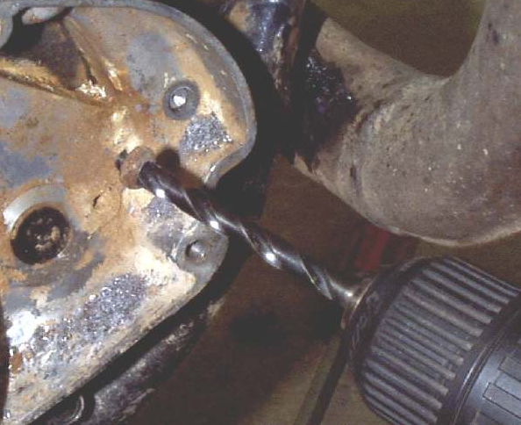
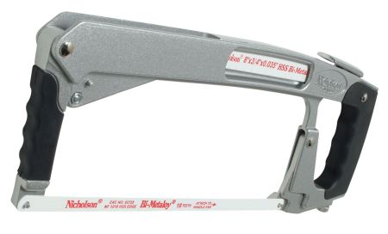


Possible solutions:
Complicated
Time consuming

Slide 4
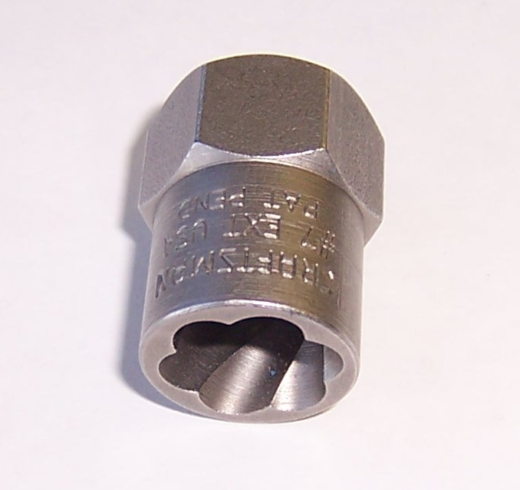
Superior solution: Fluted bolt extractor
Simple, fast, easy

Slide 5

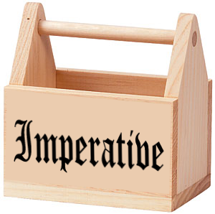
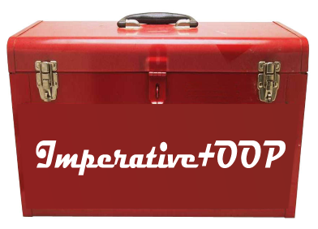
Evolution of many developers toolsets
Imperative (Pascal, C, VB)
Imperative+OOP (C++, Java, .NET 1.0/1.1)
Imperative+OOP/Functional (.NET 2.0-3.5, F#)
Are we making good use of new functional tools that can help us solve problems in a superior way than imperative or OO.
Imperative+OOP/Functional/Dynamic (Multi-Paradigm)

Slide 6
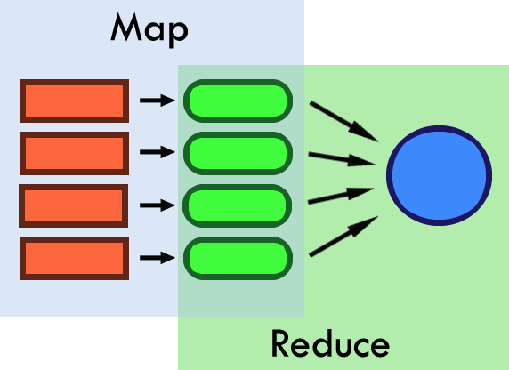
Map/Reduce (.NET 3.5/F#)
(Not to be confused with Google MapReduce)
Map: Convert each item in a list.
Reduce: fold all items down into a single item.

Slide 7
Map
Takes a function to convert an individual item and returns the new list.
Linq – IEnumerable/IQueryable.Select()
F#: List/Seq.map
Lets see some code!

